Slide 1
General Project Background
Generally interested in tracking objects (vehicles) using a downward looking camera system
Extract information about the position/track of the vehicle
When did it enter/exit
Where did it enter/exit
How fast is it moving
Extract physical characteristcs about the vehicle itself
Length/width/profile
What type of vehicle (FHWA class maybe?)
Camera is expected to be 30 fps, full color, 988x751 pixels
Overall solution targeted at keeping up within 1-1.5 seconds of realtime
Raytheon Proprietary

Slide 2
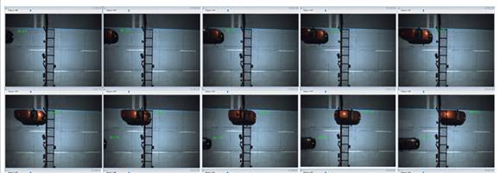
Current Data Sample
Raytheon Proprietary

Slide 3
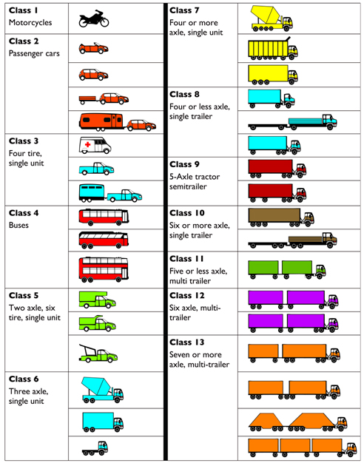
Vehicle Classification
Two major trends: Shape or Axle count
Often shape uses a subset of FHWA classes (to the right)
Combines and simplifies different types of tractor trailer or trucks
Axle count is exactly that: how many axles are touching the ground
Raytheon Proprietary

Slide 4
Possible ML stack
We have used the following:
Linux, CUDA, Anaconda (python), Tensorflow, Keras.
With an end target of running on the Nvidia Jetson TX2i
Raytheon Proprietary

Slide 5
Video Annotation Plan
On a per-frame basis:
License Plate position (both front and back, but not associated)
Allows for position of plate, and also truth of start/end of vehicles
Position of axle
If there is a camera movement/jump so this can be excluded from training
If there are no vehicles in frame
Raytheon Proprietary

